Slide 1
MUTATION TESTING

Slide 2
Mutation Testing
How to assess the effectiveness of selected test suite?
Is this test suite adequate for the program?

Slide 3
Mutation Testing
If the test suite is not able to make the program fail, there may be one of the following reasons:
Test suit is effective but hardly any errors are there in the program.
Test suite is not effective and could not find any errors.

Slide 4
Mutation Testing
Mutation and Mutants
Process of changing a program is known as mutation.
Prepare a copy of the program under test and make a change in a statement of the program.
This changed version of the program is known as a mutant of the original program.

Slide 5
Mutation Testing
Mutation and Mutants
Mutants generated by making only one change are known as first order mutants.
Second order mutants may be obtained by making two changes and so on……….

Slide 6
Mutation Testing
1 | void main()
2 | {
3 | float A,B,C;
4 | clrscr();
5 | printf("Enter number 1:\n");
6 | scanf("%f", &A);
7 | printf("Enter number 2:\n");
8 | scanf("%f", &B);
9 | printf("Enter number 3:\n");
10 | scanf("%f", &C);
11
12 | if(A>C) {
13 | printf("The largest number is: %f\n",A);
14 | }
15 | else {
16 | printf("The largest number is: %f\n",C);
17 | }
18 | }
19 | else {
20 | if(C>B) {
21 | printf("The largest number is: %f\n",C);
22 | }
23 | else {
24 | printf("The largest number is: %f\n",B);
25 | }
26 | }
27 | getch();
28 | }
Mutated statement (‘>’ is replaced by ‘=‘)
if(A>B){
if(A=B){

Slide 7
Mutation Testing
Mutation Operators
Mutants are produced by applying mutant operators.
An operator is essentially a grammatical rule that change a single expression to another expression.
Higher order mutants are difficult to manage, control and trace.
To kill a mutant, we should be able to execute the changed statement of the program.

Slide 8
Mutation Testing
Mutation Operators for OO languages like Java, C++:
Changing the access modifier, like public to private.
Static modifier change
Argument change
Super keyword change
Operator change
Any operand change by a numeric value

Slide 9
Mutation Testing
Mutation Score
The results of the program were affected by the change and any test case detects it. If this happens, the mutant is called a killed mutant.
The results of the program are not changed and any test case of test suit does not detect the mutation. The mutant is called a live mutant.

Slide 10
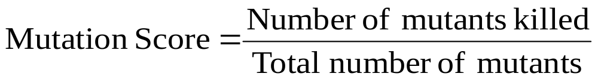
Mutation Testing
Mutation Score
The score associated with a test suite and its mutants is calculated as:
Where, total number of mutants is equal to number of killed mutant plus number of live mutants.

Slide 11
Mutation Testing
Mutation Score
Live mutants are important and should be analyzed thoroughly.
New test cases should be written for live mutants and all these mutants should be killed.
Test cases that identify the changed behavior should be preserved and transferred to original test suite in order to enhance the capability of the test suite.

Slide 12
Mutation Testing
Consider the program to find largest of three numbers. The test suite selected by a testing technique is given as:
Test case | A | B | C | Expected output
1 | 6 | 10 | 2 | 10
2 | 10 | 6 | 2 | 10
3 | 6 | 2 | 10 | 10
4 | 6 | 10 | 20 | 20

Slide 13
Mutation Testing
Solution:
Mutant No. | Line no. | Original line | Modified Line
M₁ | 11 | if(A>B) | if (A<B)
M₂ | 11 | if(A>B) | if(A>(B+C))
M₃ | 12 | if(A>C) | if(A<C)
M₄ | 20 | if(C>B) | if(C=B)
M₅ | 16 | printf(“The Largest number is:%f\n”,C); | printf(“The Largest number is:%f\n”,B);

Slide 14
Mutation Testing
Actual output of mutant 1 and 2 using given test suite
Test case | A | B | C | Expected output | Actual output
1 | 6 | 10 | 2 | 10 | 6
2 | 10 | 6 | 2 | 10 | 6
3 | 6 | 2 | 10 | 10 | 10
4 | 6 | 10 | 20 | 20 | 20
Test case | A | B | C | Expected output | Actual output
1 | 6 | 10 | 2 | 10 | 10
2 | 10 | 6 | 2 | 10 | 10
3 | 6 | 2 | 10 | 10 | 10
4 | 6 | 10 | 20 | 20 | 20

Slide 15
Mutation Testing
Actual output of mutant 3 and 4 using given test suite
Test case | A | B | C | Expected output | Actual output
1 | 6 | 10 | 2 | 10 | 10
2 | 10 | 6 | 2 | 10 | 2
3 | 6 | 2 | 10 | 10 | 6
4 | 6 | 10 | 20 | 20 | 20
Test case | A | B | C | Expected output | Actual output
1 | 6 | 10 | 2 | 10 | 10
2 | 10 | 6 | 2 | 10 | 10
3 | 6 | 2 | 10 | 10 | 10
4 | 6 | 10 | 20 | 20 | 10

Slide 16
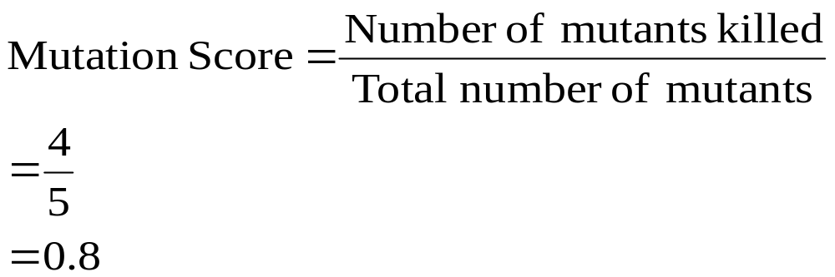
Mutation Testing
Actual output of mutant 5 using given test suite
Test case | A | B | C | Expected output | Actual output
1 | 6 | 10 | 2 | 10 | 10
2 | 10 | 6 | 2 | 10 | 10
3 | 6 | 2 | 10 | 10 | 2
4 | 6 | 10 | 20 | 20 | 20

Slide 17
Mutation Testing
Additional test case
Test case | A | B | C | Expected output
5 | 10 | 5 | 6 | 10

Slide 18
Mutation Testing
Revised Test suite
Test case | A | B | C | Expected output
1 | 6 | 10 | 2 | 10
2 | 10 | 6 | 2 | 10
3 | 6 | 2 | 10 | 10
4 | 6 | 10 | 20 | 20
5 | 10 | 5 | 6 | 10

Slide 19
Mutation Testing
Consider the program for classification of triangle given in figure 3.18. The test suite A and B are selected by two different testing techniques and are given in table 4.31 and table 4.32, respectively. The five first order mutants and the modified lines are given in table 4.33. Calculate the mutation score of each test suite and compare their effectiveness. Also, add any additional test case, if required.

Slide 20
Mutation Testing
Test case | a | b | c | Expected output
1 | 30 | 40 | 90 | Invalid triangle
2 | 30 | 20 | 40 | Obtuse angled triangle
3 | 50 | 40 | 60 | Acute angled triangle
4 | 30 | 40 | 50 | Right angled triangle
5 | -1 | 50 | 40 | Input values are out of range
6 | 50 | 150 | 90 | Input values are out of range
7 | 50 | 40 | -1 | Input values are out of range

Slide 21
Mutation Testing
Test case | a | b | c | Expected output
1 | 40 | 90 | 20 | Invalid triangle
2 | 40 | 30 | 60 | Obtuse angled triangle
3 | 40 | 50 | 60 | Acute angled triangle
4 | 30 | 40 | 50 | Right angled triangle
5 | -1 | 50 | 40 | Input values are out of range
6 | 30 | 101 | 90 | Input values are out of range
7 | 30 | 90 | 0 | Input values are out of range

Slide 22
Mutation Testing
Mutant No. | Line no. | Original line | Modified Line
M₁ | 13 | if(a>0&&a<=100&&b>0&&b<=100&&c>0&&c<=100) { | if(a>0||a<=100&&b>0&&b<=100&&c>0&&c<=100) {
M₂ | 14 | if((a+b)>c&&(b+c)>a&&(c+a)>b) { | if((a+b)>c&&(b+c)>a&&(b+a)>b) {
M₃ | 21 | if(valid==1) { | if(valid>1) {
M₄ | 23 | a2=(b*b+c*c)/(a*a); | a2=(b*b+c*c)*(a*a);
M₅ | 25 | if(a1<1||a2<1||a3<1) { | if(a1>1||a2<1||a3<1) {

